Slide 1


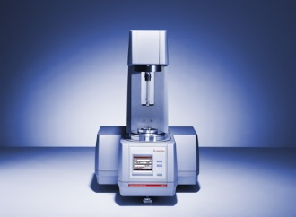



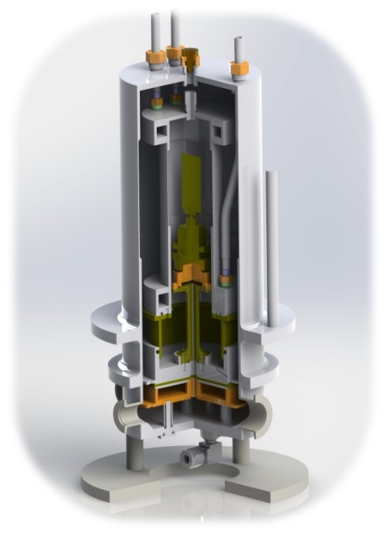
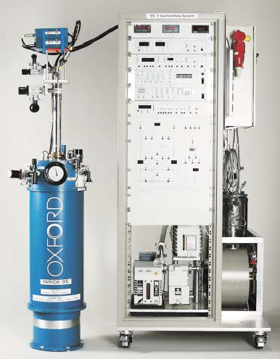





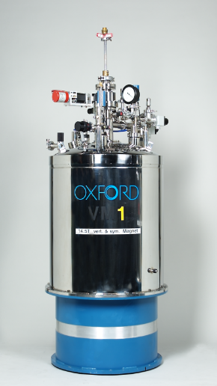

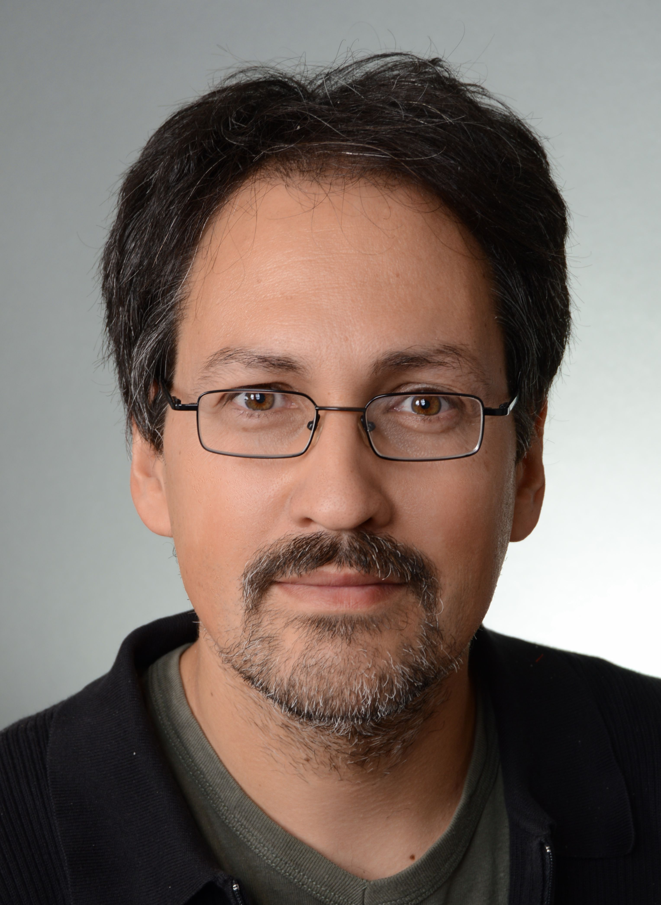






SECoP and metadata – the sample environment communication protocol
K. Kieferª, B. Klemkeª, L. W. Rossaª, P. Wegmannª, J. Kotanski^{b}, T. Kracht^{b}, N. Ekström^{c}, A. Pettersson^{c}, G. Brandl^{d}, E. Faulhaber^{e}, and M. Zolliker^{f}
ªHelmholtz-Zentrum Berlin, Hahn-Meitner-Platz 1, 14109 Berlin, Germany - ^{b}Deutsches Elektronen-Synchrotron DESY, Notkestraße 85, D-22607 Hamburg, Germany - ^{c}European Spallation Source, Partikelgatan 2, 224 84 Lund, Schweden –
^{d}Jülich Centre for Neutron Science JCNS at Heinz Maier-Leibnitz Zentrum (MLZ) Forschungszentrum Jülich GmbH, Lichtenbergstraße 1, 85748 Garching, Germany – ^{e}Forschungs-Neutronenquelle Heinz Maier-Leibnitz, Lichtenbergstraße 1, 85748 Garching, Germany -
^{f}Paul Scherrer Institut, Forschungsstrasse 111, 5232 Villigen, Switzerland
The integration of sample environment (SE) equipment in a beam line experiment is a complex challenge both in the physical world and in the digital world. Different experiment control software offer different interfaces for the connection of SE equipment. Therefore, it is time-consuming to integrate new SE or to share SE equipment between facilities. To tackle this problem, the International Society for Sample Environment (ISSE) developed the Sample Environment Communication Protocol (SECoP) to standardize the communication between instrument control software and SE equipment*. SECoP offers, on the one hand, a generalized way to control SE equipment. On the other hand, SECoP holds the possibility to transport SE metadata in a well-defined way. In addition, SECoP provides machine readable self-description of the SE equipment which enables a fully automated integration into the instrument control software and into the processes for data storage. Using SECoP as a common standard for controlling SE equipment and generating SE metadata will save resources and intrinsically give the opportunity to supply standardized and FAIR data compliant SE metadata. It will also supply a well-defined interface for user-provided SE equipment, for equipment shared by different research facilities and for industry. In this presentation we will present SECoP and the SECoP@HMC project supported by the Helmholtz Metadata Collaboration.
The SECoP Idea
The SECoP Philosopy
SECoP Goals
Experiment Control Software
Standardize the control of SE equipment
Standardize the provision of metadata for SE equipment
Enable plug&play operation of SE equipment
Ease the exchange of SE equipment
SECoP
Sample Environment Communication Protocol
simple, inclusive,
self explaining,
provides metadata
Rheometer, anton-paar.com
SECoP@HMC Work Packages
WP1: Standards for Sample Environment metadata in SECoP
(K. Kiefer, HZB)
WP2: Standards for storage of Sample Environment metadata
(T. Kracht, DESY) WP3: Implementation into experimental control systems
(G. Brandl, FZJ) WP4: Outreach, Dissemination & Training
(M. Uhlarz, HZDR)
Humidity cell, HZB/ILL
Dilution Stick, Oxford Instruments
Structure
Message example
ECS
SECnode (“wet cryostat”)
temperature_sample (module)
- value (parameter)
- _sensor_value
- _calibration_table
- status, …
temperature_reg
- value
- target
- ramp
- stop (command)
- ctrlpars [p, i, d, …]
- control_active
- status, …
heliumlevel
- value
- status
read request request read module:parameter
reply reply module:parameter value
change value request change module:parameter value
reply changed module:parameter value
SECnode1
Properties
SECnode2
Further develop SECoP standard, libraries and programming frameworks
Publish SECoP SEC-Node structures for standard applications as examples (on GitHub, including metdata definitions)
Develop the mapping SECoP to Nexus for metadata and data
Integrate SECoP in different experimental control systems (e.g. BlueSky, Tango,…)
Module1.1
Properties
Module2.1
Module2.2
> read temp1:value
< reply temp1:value [295.13,{"t":1505396348.188}]
> change temp1:target 295
< changed temp1:target [300,{ "t":1505396349.123}]
Parameter1
Parameter2
Parameter3
…
Command1
Command2
Properties
SECnode module:parameter
module:command
Metadata in SECoP
Metadata plug&play
Parameter
Properties
Predefined parameters
value, status, target, ramp, …
Interface classes
Readable, Writable, Drivable
complex interface classes
Module property „meaning“
meaning (tuple, optional)
INTERESTED?
Calibration curve
of a sensor (static)
Additional information
(e.g. valve position,
Helium level,…)
description
equipment_id of a SEC-node
"temperature" (the sample temperature)
"temperature_regulation" (to be specified only if different from 'temperature')
"magneticfield"
"electricfield"
"pressure"
"rotation_z" (counter clockwise when looked at 'from sky to earth')
"humidity"
"viscosity"
"flowrate"
"concentration"
Contact the SECoP working group
Get started with SECoP
description
meaning of a module
description
datainfo of a parameter
An introduction to SECoP
[1] K. Kiefer, et al. (2020). An introduction to SECoP – the sample environment communication protocol. Journal of Neutron Research, 21(3-4), pp.181–195
https://doi.org/10.3233/jnr-190143
SECoP on GitHub
https://github.com/SampleEnvironment/SECoP
International Society for Sample Environment (ISSE)
https://sampleenvironment.org/
Helmholtz Metadata Collaboration:
https://helmholtz-metadaten.de/de
Partners
More Information
Dr. Klaus Kiefer
Dr. Markus Zolliker
klaus.kiefer@helmholtz-berlin.de
Helmholtz-Zentrum Berlin für Materialien und Energie
Hahn-Meitner-Platz 1
14109 Berlin, Germany
Paul Scherrer Institut
Forschungsstrasse 111
5232 Villigen, Switzerland
The project SECoP@HMC is part of the HMC project cohort 2021
and receives funding by the
Initiative and Networking Fund (INF) of the Helmholtz Association

